Slide 1
Chapter 15 & 16 Objectives
Understand the similarities and distinctions between 2 types of endocytosis
Understand the role of vesicles, endosomes, & lysosomes in endocytosis
Understand the role of ligand, receptor and effector proteins in cell signaling
Be able to describe key features of the 3 main classes of cell surface receptors

Slide 2
Import without pores
Endoplasmic Reticulum (ER)

Slide 3
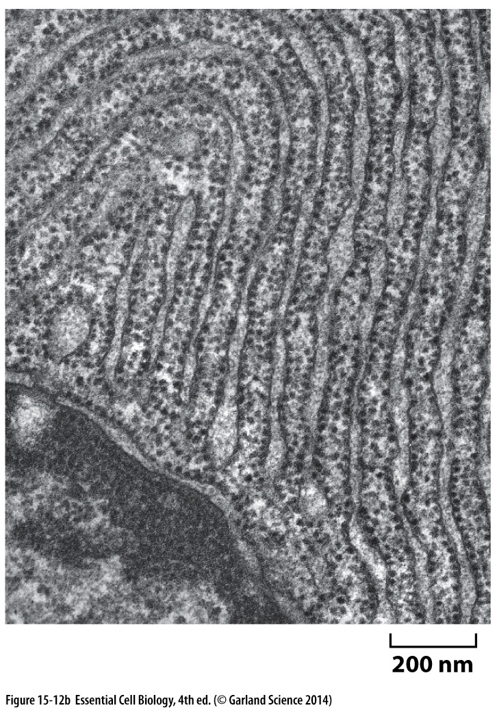
Import into the ER
Most extensive membrane system of the cell
Protein trafficking hub
Source of membrane for other organelles growing cell
Proteins are synthesized on the subset of ribosomes bound to the outer ER membrane
Soluble proteins transported into the ER lumen
Transmembrane proteins inserted into the ER membrane
‘Rough’ ER

Slide 4
Import into the ER
On the surface, looks much like import into mitochondria and chloroplasts:
Similarities:
Need signal/localization sequence
Need protein translocator
Differences:
No chaperones needed
Signal peptide remains in the membrane
Protein can be fully transported, or remain in the membrane

Slide 5
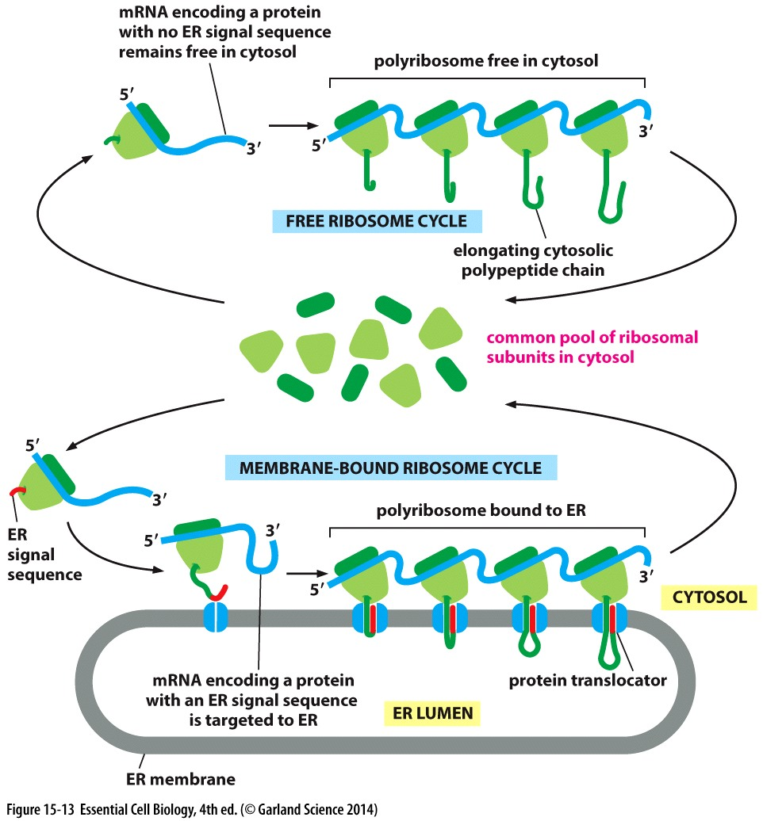
Import into the ER
Many free ribosomes bind a new mRNA and begin translating it = polyribosome
mRNA has an ER localization signal → recruited to the ER by signal receptor
Soluble protein
Growing peptide chain is pushed through a protein translocator into the lumen
Force of synthesis is sufficient, no extra energy needed

Slide 6
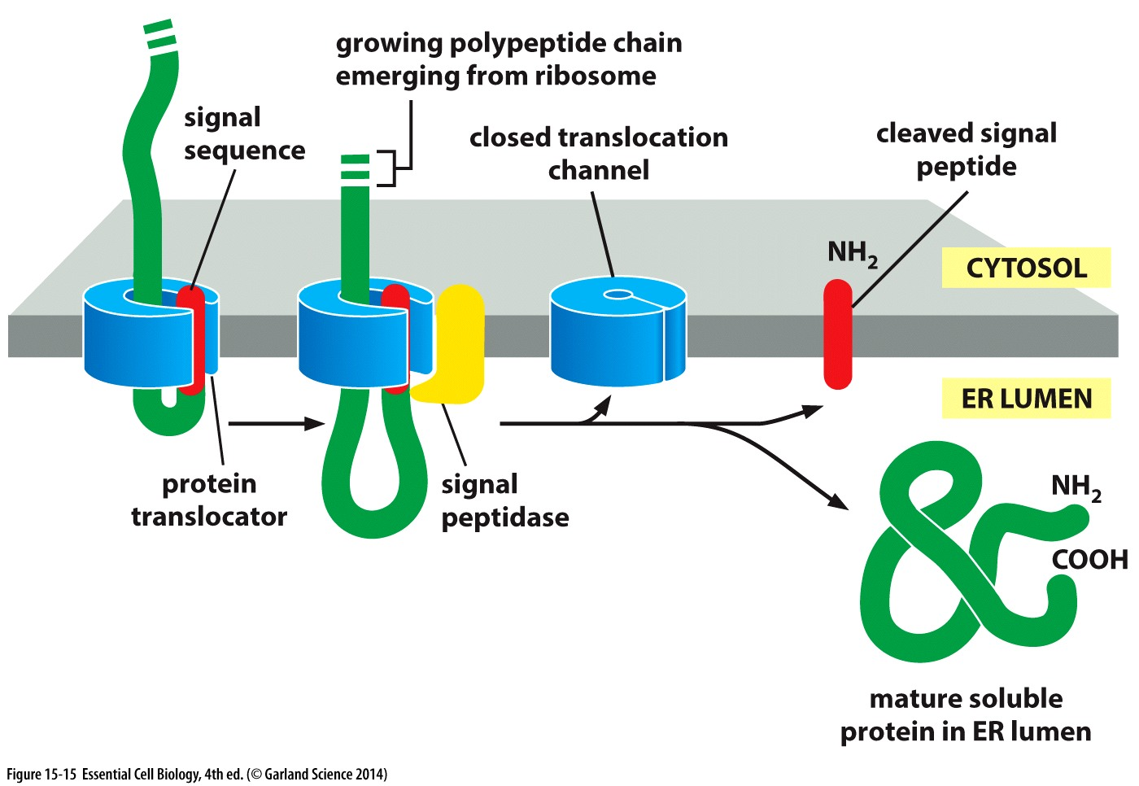
Signals to start and stop: soluble vs transmembrane
Cleavage of the signal sequence releases the newly synthesized protein into the ER lumen

Slide 7
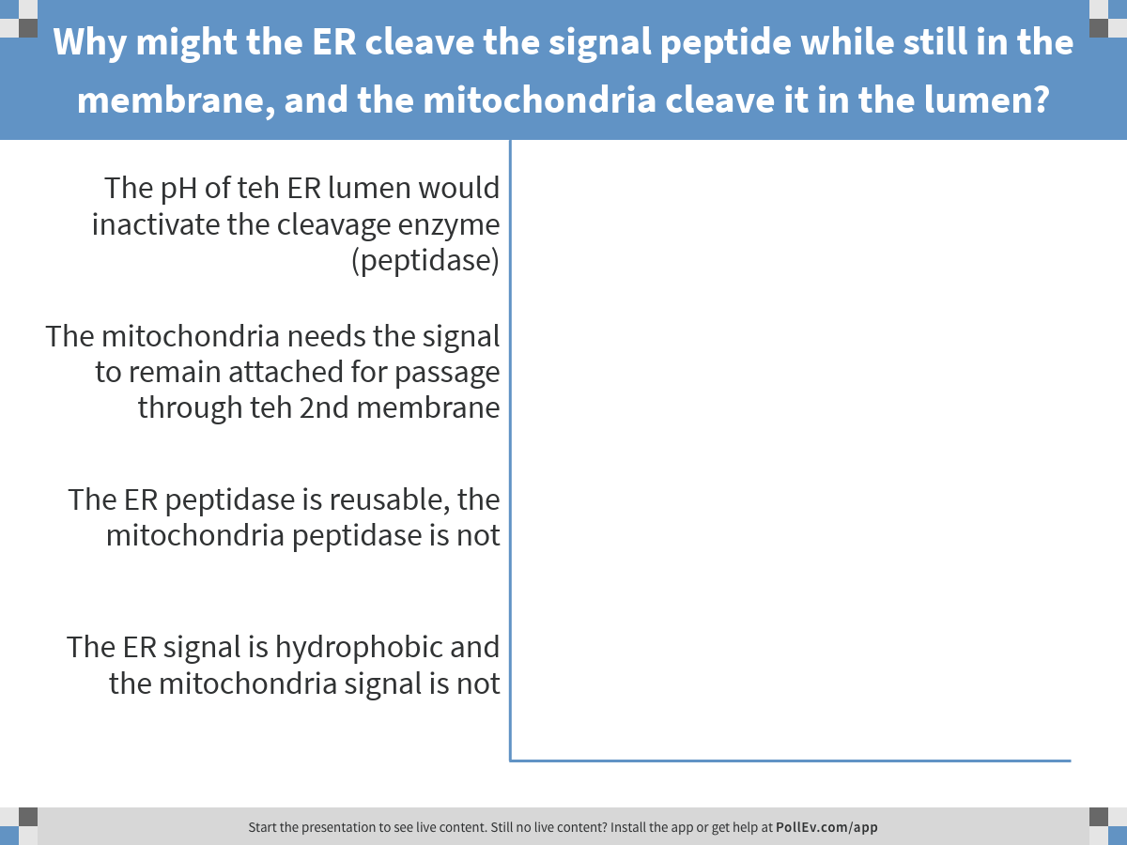
Thinking about similarities and differences between mitochondria and ER..
Notes:
Why might the ER cleave the signal peptide while still in the membrane, and the mitochondria cleave it in the lumen?
https://www.polleverywhere.com/multiple_choice_polls/tAJcgdwjAd7jxa1

Slide 8
Signals to start and stop: soluble vs transmembrane
Chaperone proteins INSIDE ER lumen assist in folding transported proteins
Cleavage of the signal sequence releases the newly synthesized protein into the ER lumen

Slide 9
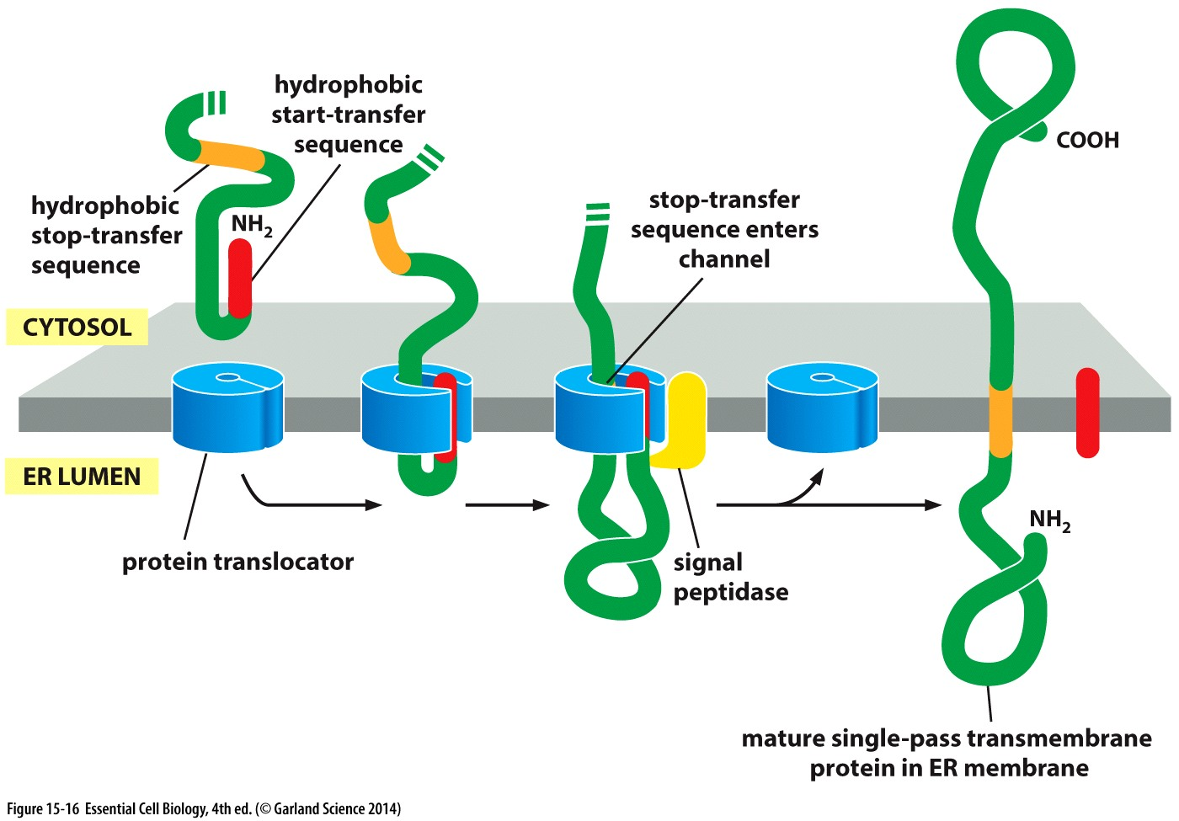
Signals to start and stop: soluble vs transmembrane
A defined ‘stop translocation’ signal allows the remainder of the synthesized protein to remain cytosolic

Slide 10
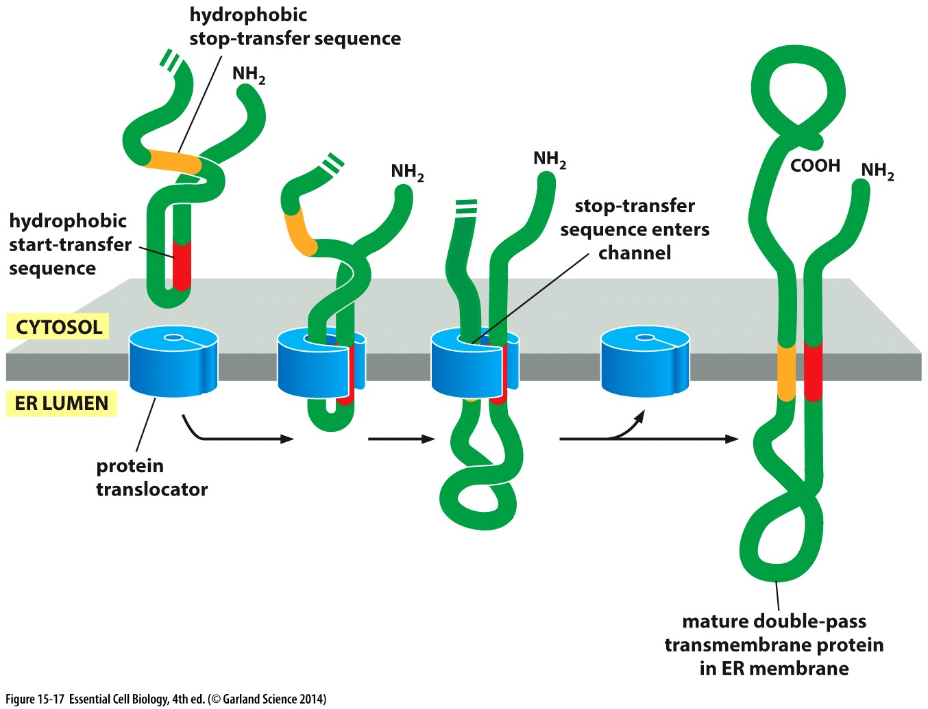
Signals to start and stop: soluble vs transmembrane
A ‘start translocation’ signal distinct from the amino terminus, together with a ‘stop’ sequence allows for two transmembrane regions

Slide 11
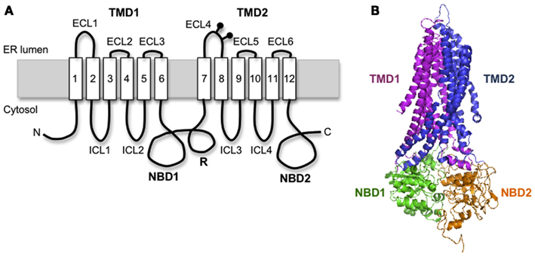
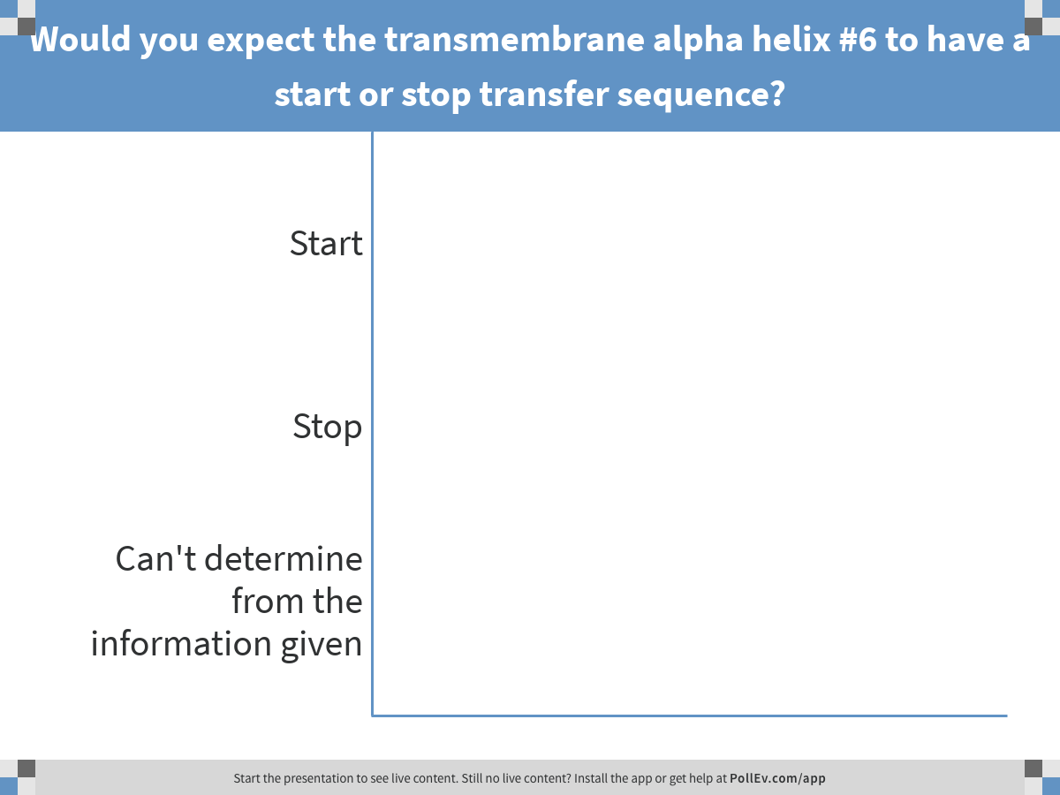
Consider the following transmembrane ER protein…
Notes:
Would you expect the transmembrane alpha helix #6 to have a start or stop transfer sequence?
https://www.polleverywhere.com/multiple_choice_polls/iOtNXLFNM2kYgVw

Slide 12
Consider the following transmembrane protein…
S
E
S
E
S
E
S
E
S
E
S
E
End of protein
Start of protein
Where would you expect to find stop and start transfer sequences?
S= start transfer; E = end/stop transfer

Slide 13
Transport vesicles

Slide 14
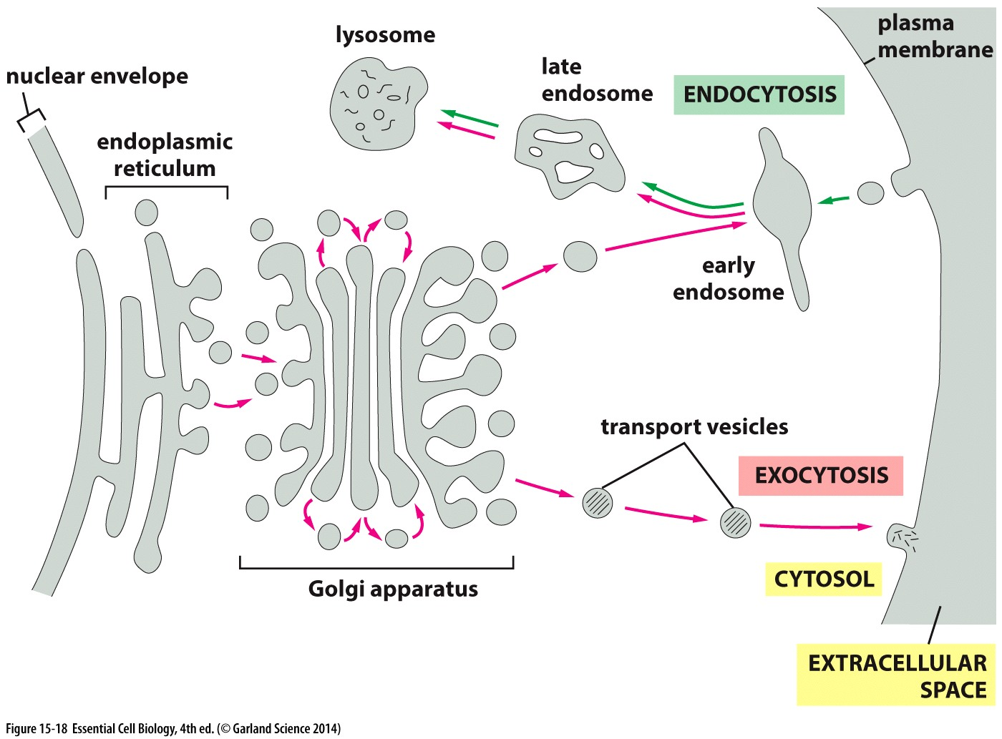
Transport vesicles carry soluble proteins and membrane between compartments
Includes proteins integrated in membranes

Slide 15
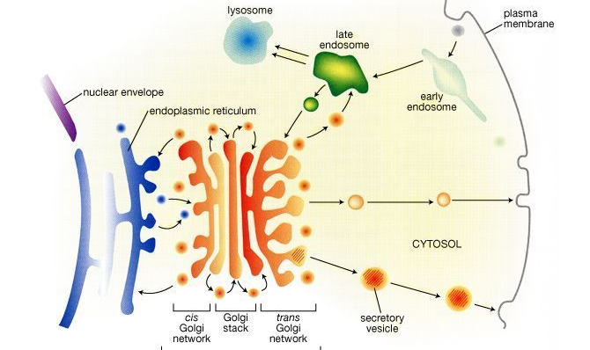
Protein Trafficking: an overview
Endocytosis
Water uptake
Internalize large particles/small cells
More modifications
Sorting
+ covalent modifications
Quality Control
Unregulated:
Constitutive secretion
Membrane growth
Regulated:
Released in response to extracellular signal
Protein: made
on Rough ER

Slide 16
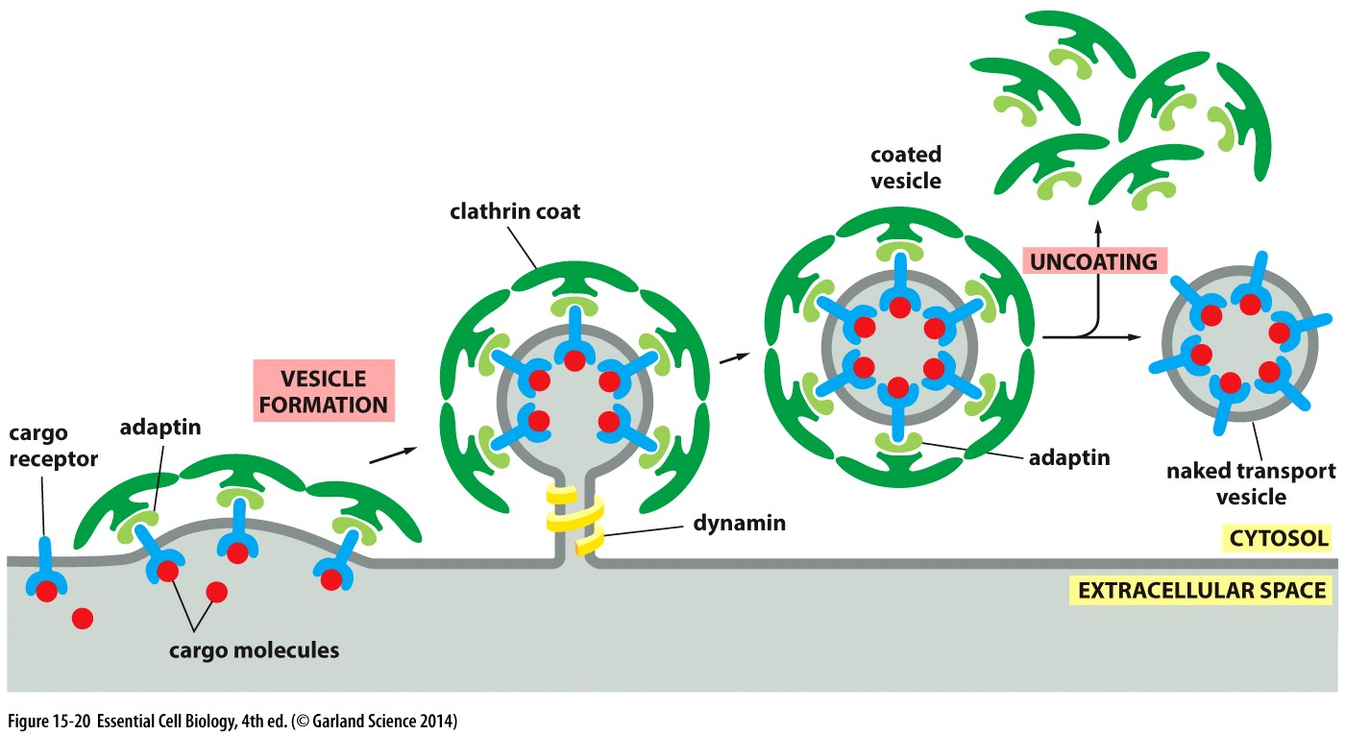
Making vesicles
Membrane proteins signal for vesicle formation
Recruit adaptor proteins → recruit coat proteins
Coat proteins induce curvature of the membrane
Dynamin/GTP hydrolysis + other proteins → pinch off vesicle
Coat is shed → naked vesicle can interact with other membranes

Slide 17
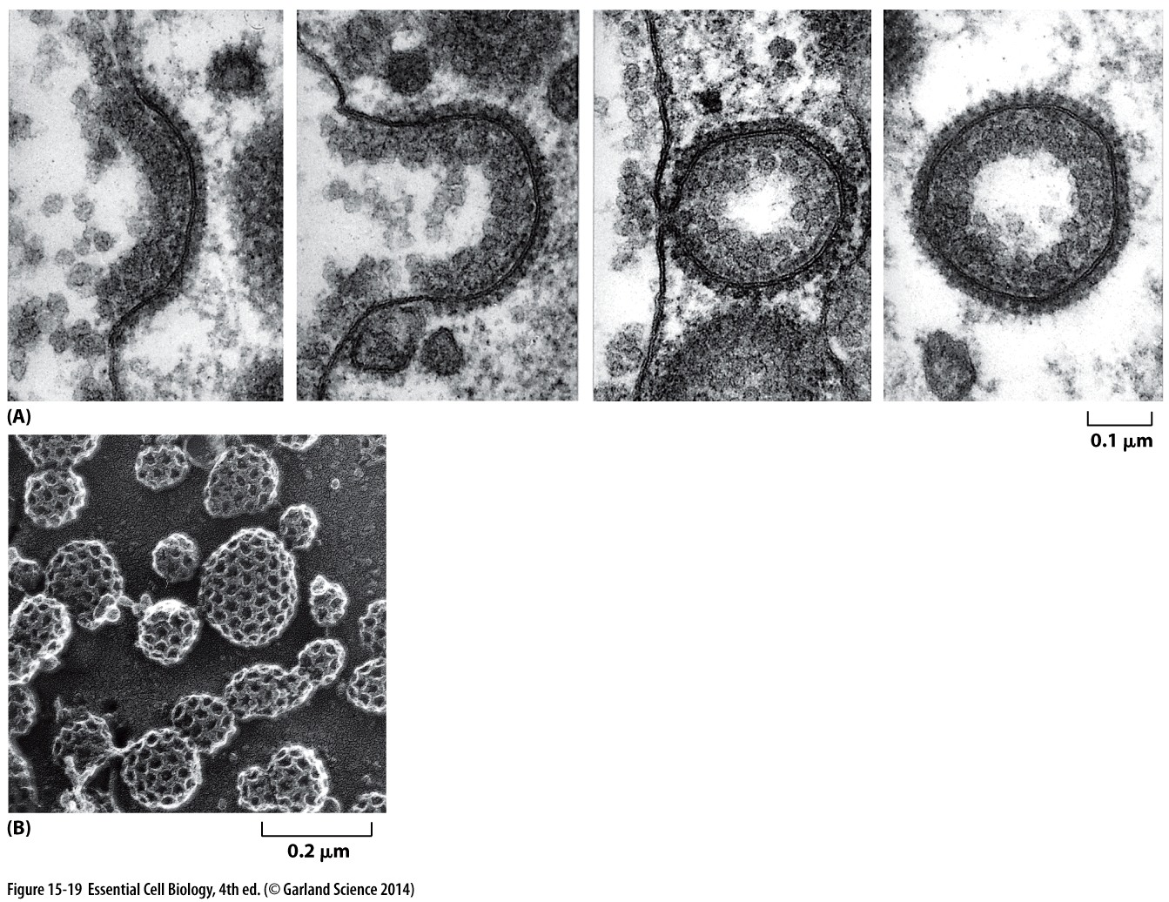
Targeting and specificity
Cargo receptors specify the cargo
→ adaptors choose which receptors are packaged into vescicles
Soluble molecules to be packaged into vesicles have transport signals that receptors recognize

Slide 18
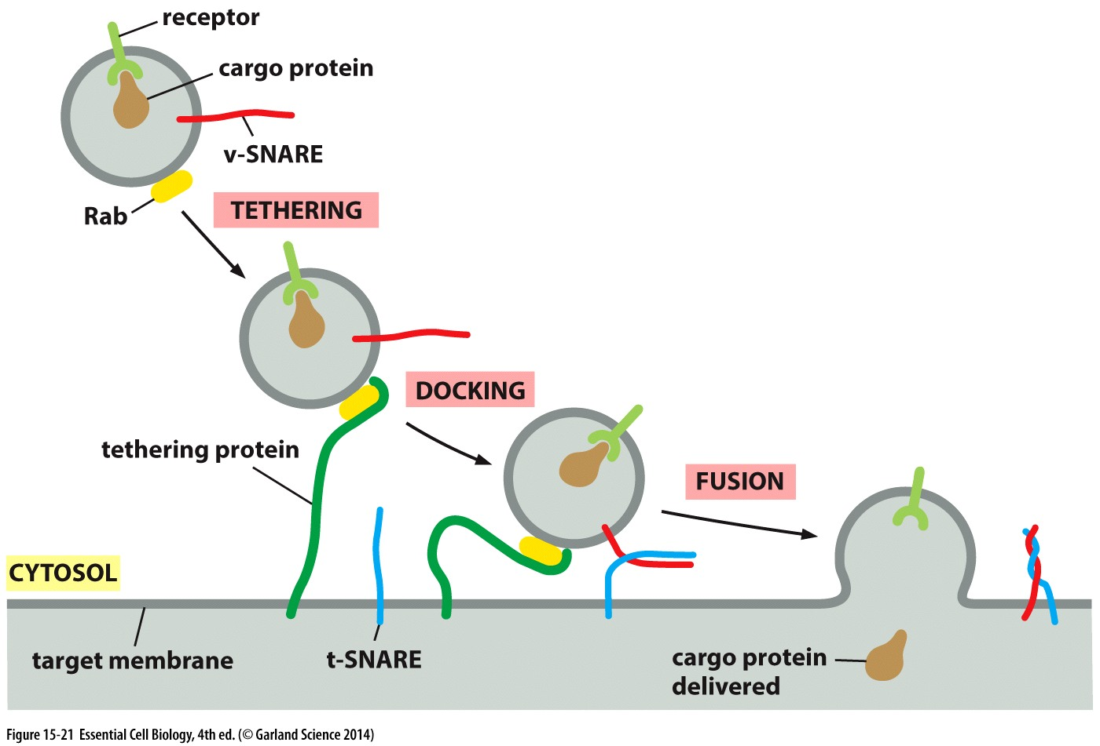
Delivering cargo
Motors and cytoskeleton tracks move vesicles to their target membrane
One there, they must dock and fuse:

Slide 19
Docking
Rabs: membrane/vesicle specific GTP hydrolase (GTPase) on the surface → find and bind:
Tethering proteins: specific for each membrane
Targeting: Specific combinations of Rab:tether

Slide 20
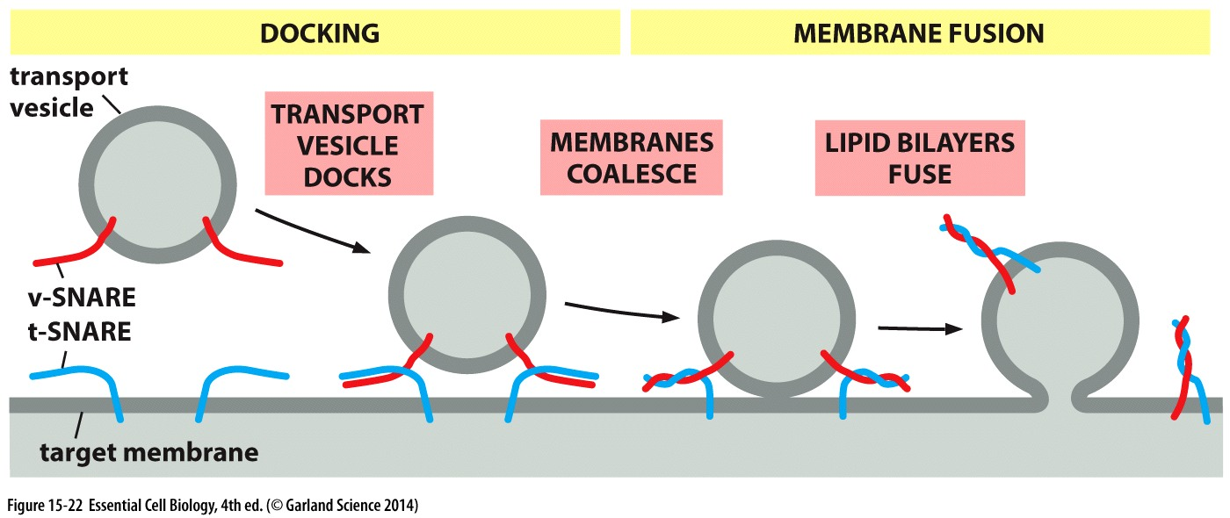
Fusion
Water displaced = very unfavorable
Each vesicle has transmembrane v-SNARE proteins
Each membrane has transmembrane t-SNARE proteins
tSNARE:vSNARE interactions:
Firmly dock vesicles on the correct membrane
Facilitate fusion of lipid bilayers → cargo is released

Slide 21
The goals of protein sorting and trafficing
An overview

Slide 22
Specific functions need specific composition
Membranes are fluid and sometimes interconnected: how are specific compositions directed and maintained both in the membranes, and within the organelles?
Step 1: Regulate membrane fluidity
Hydrocarbon saturation
More sat = less fluid
Sterol and protein composition
Less phospholipid movement (lateral/rotation/flexion)→ less fluid
Transmembrane protein interactions constrain by binding others:
External
Internal
Other transmembrane or membrane bound proteins (in other cells, include tight junctions)

Slide 23
Specific functions need specific composition
Membranes are fluid and sometimes interconnected: how are specific compositions directed and maintained both in the membranes, and within the organelles?
Step 2: Regulate membrane composition
Lipids: Scramblases and flippases
distinct lipid composition of inner and outer bilayer
Proteins: insert and transport with rough ER & vesicles
ER localization signal + protein translocator + start/stop transfer sequences → into the ER membrane
Receptor/adaptin/coat + Rab/tether/SNAREs → traffic vesicle to desired target membrane

Slide 24
Specific functions need specific composition
Membranes are fluid and sometimes interconnected: how are specific compositions directed and maintained both in the membranes, and within the organelles?
Step 3: Regulate internal (lumen) molecule composition
Small soluble ions and molecules
Targeted transport into the organelle
Challenge: hydrophilic molecules cross lipid bilayer
Solution: Channels and transporters (Active vs passive)
Large soluble macromolecules (like proteins)
Pores
Translocators
Vesicles
Localization signal?
Energy requirement source?
Folded vs unfolded?
Receptor?

Slide 25
Step 3: Regulate internal (lumen) molecule composition
Large soluble macromolecules (like proteins) are transported through membrane- bound compartments by:
Pores
Translocators
Vesicles
Localization signal?
Energy requirement?
source?
Folded vs unfolded?
Receptor?

Slide 26
Endocytosis
Internalization of fluid, molecules, & membrane

Slide 27
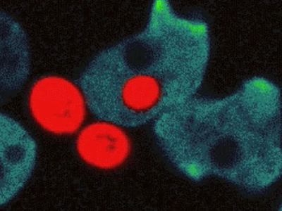
Endocytosis
Phagocytosis
Cellular eating
Ingestion of large particles
Like bacteria
Trafficking to phagosome/lysosome for digestion
Slime mold Dictostelium (green) ingesting yeast cells (red)

Slide 28
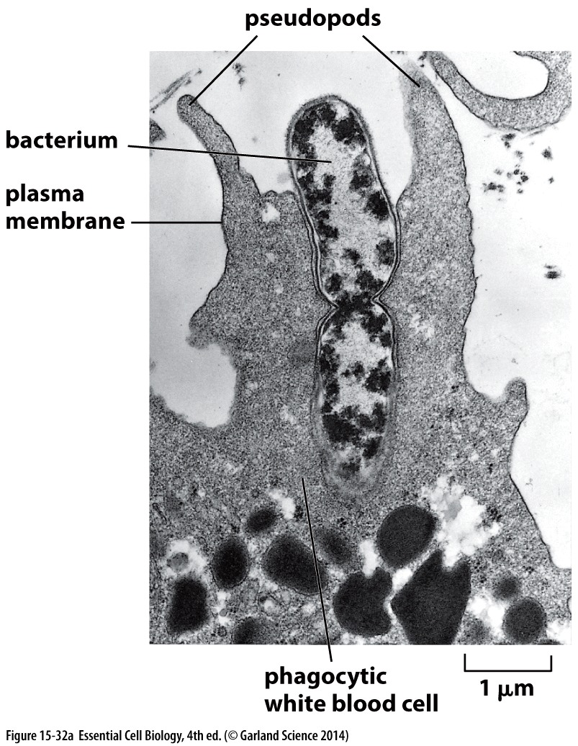
Endocytosis
Phagocytosis
Cellular eating
Ingestion of large particles
Like bacteria
Trafficking to phagosome/lysosome for digestion
Most cells in multicellular organisms can’t do this efficiently
Only specialized cells like macrophages, neutrophils (movie from lecture 10)
Engulf the large particle with plasma membrane and fuse

Slide 29
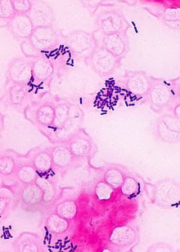
Cell Bio Research: Informing Disease Study and Treatment
Hijacking the system:
Listeria (bacteria that causes severe food poisoning)
Display cell surface markers that initiate endocytosis
Once inside:
Utilize cellular machinery to move, reproduce, and infect new cells
Remain intracellular→ avoid detection and elimination by immune response
https://www.youtube.com/watch?v=sF4BeU60yT8

Slide 30
Endocytosis
Phagocytosis
Pinocytosis
Cellular eating
Ingestion of large particles
Like bacteria
Trafficking to phagosome/lysosome for digestion
Most cells in multicellular organisms can’t do this efficiently
Only specialized cells like macrophages, neutrophils (movie from lecture 10)
Engulf the large particle with plasma membrane and fuse
Cellular drinking
Ingestion of fluid and molecules
Continuous in eukaryote cells
Utilize clathrin-coated vesicles
Takes up~1/4 its cell volume in extra cellular fluid (and any molecules dissolved in it) each hour

Slide 31
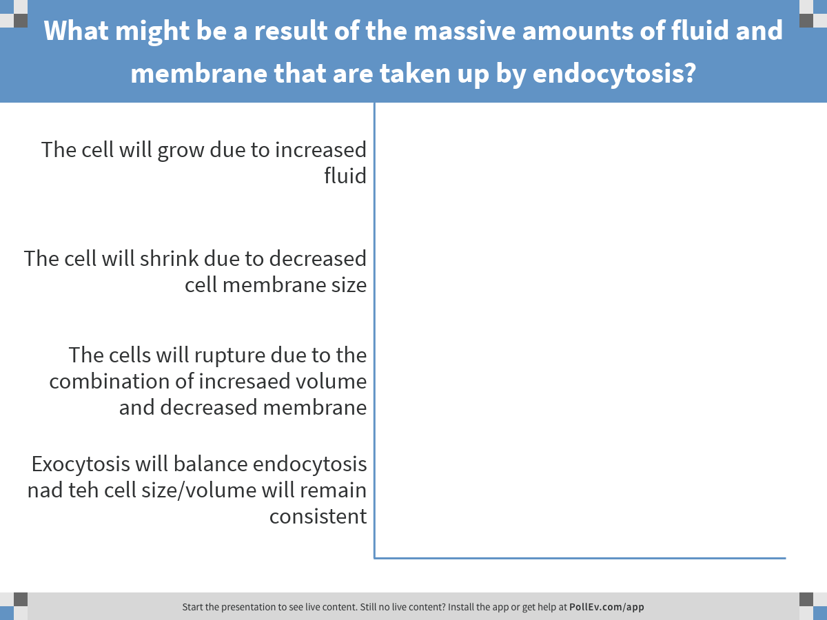
Notes:
What might be a result of the massive amounts of fluid and membrane that are taken up by endocytosis?
https://www.polleverywhere.com/multiple_choice_polls/nfqXLZR5SCQWwqb

Slide 32
Endocytosis is balanced by Exocytosis

Slide 33
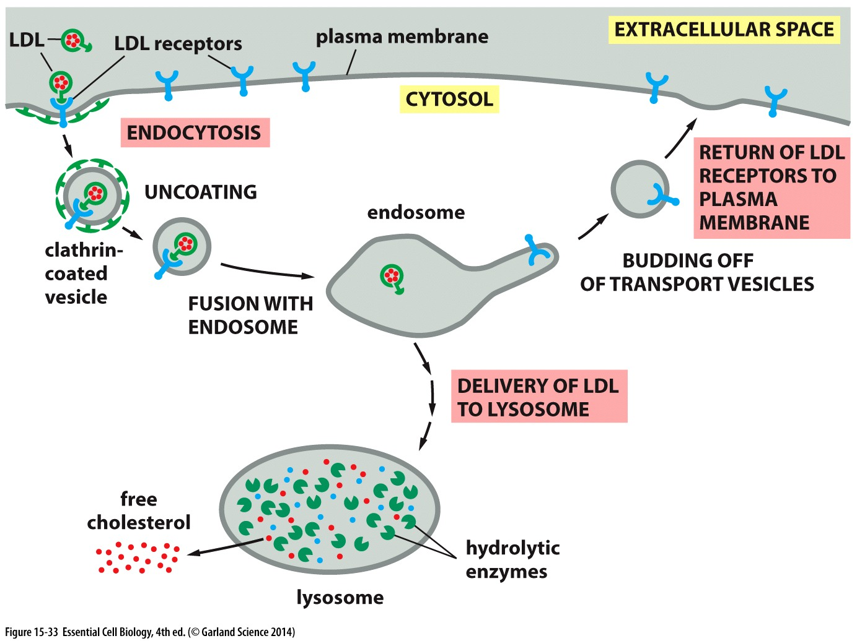
Challenge
Endocytosis alone is indiscriminate & inefficient at taking in extracellular molecules at low concentration → many vesicles (and fluid) brought into the cell
Solution
Receptor mediated
Transmembrane receptors bind extracellular cargo
Concentrates molecular ‘cargo’ → fewer vesicles (and fluid) needed for same cargo
Hydrolyze (break) covalent bonds that hold macromolecules together

Slide 34
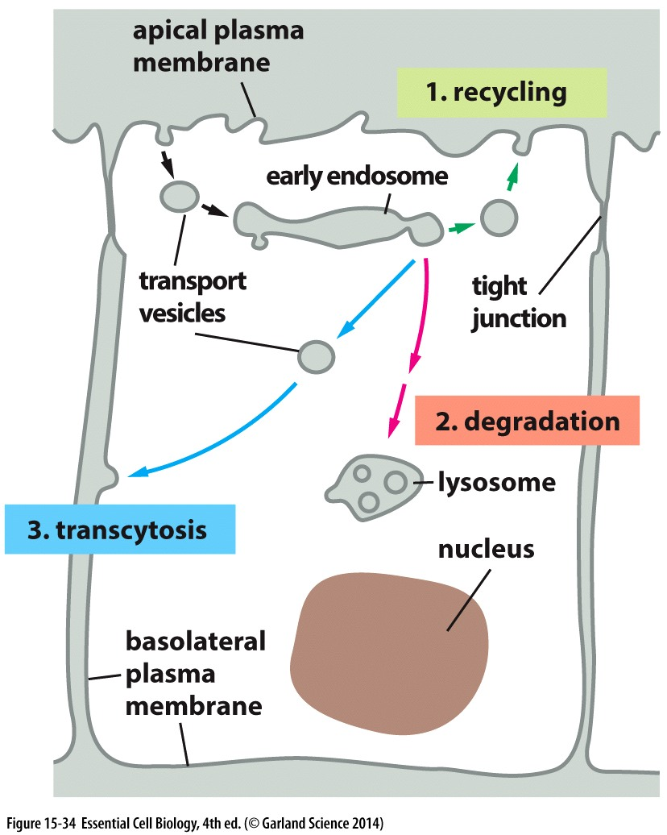
Where does endocytosed membrane go?
Fluid and molecules to the endosome
Acidic environment releases ligand for sorting
Fuse with lysosome
Membranes directed by receptors
Back to the cell membrane
To the lysosome for degradation
To a different membrane
Is endosome pH doesn’t release ligand it goes too!

Slide 35
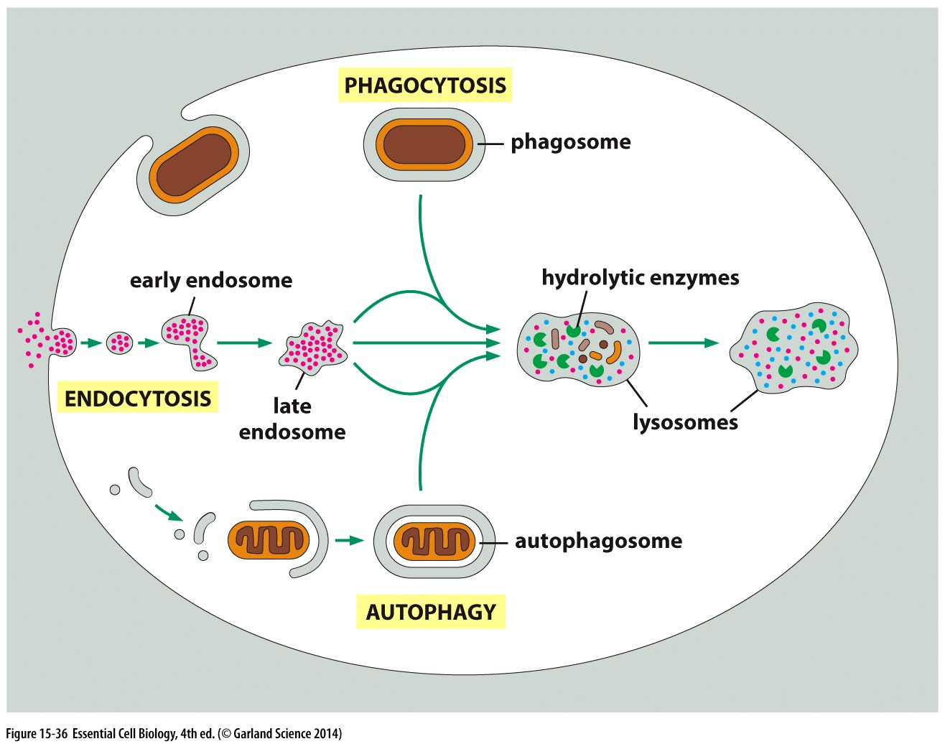
All paths lead to the lysosome
Endocytosed material destined for degradation → lysosome
Acid-activated hydrolytic enzymes break covalent bonds
Release/recycle subunits
Engulfment of large particles: bacteria, cell debris
Take up of small molecules from extracellular space
Digestion of damaged or excess cellular components: starved or extensive remodeling

Slide 36
Cell signaling

Slide 37
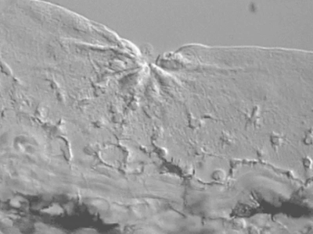
Communicating with signaling molecules
Signaling cell → damaged cells
Extracellular signaling molecule → chemical signal released by damaged cells
Target cell → lymphocytes
Response by target cell → “crawls” towards the signal to phagocytose/clear damaged cells

Slide 38
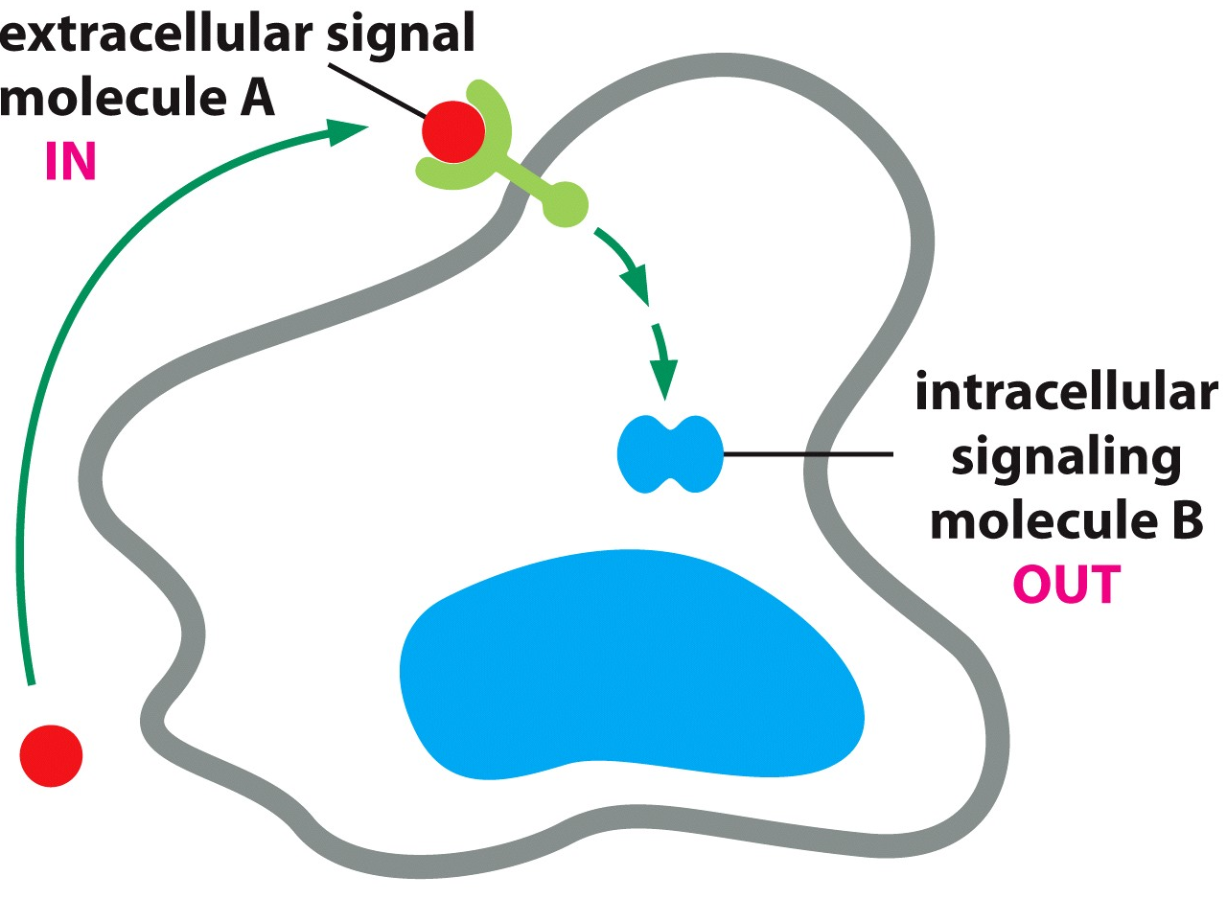
Cell signaling requires an INPUT and an OUTPUT
Input comes from extracellular source
Target cell typically has membrane-bound receptor
Incoming signal is converted→ output intracellular signal that alters cell behavior
Most cells can both send and receive messages

Slide 39
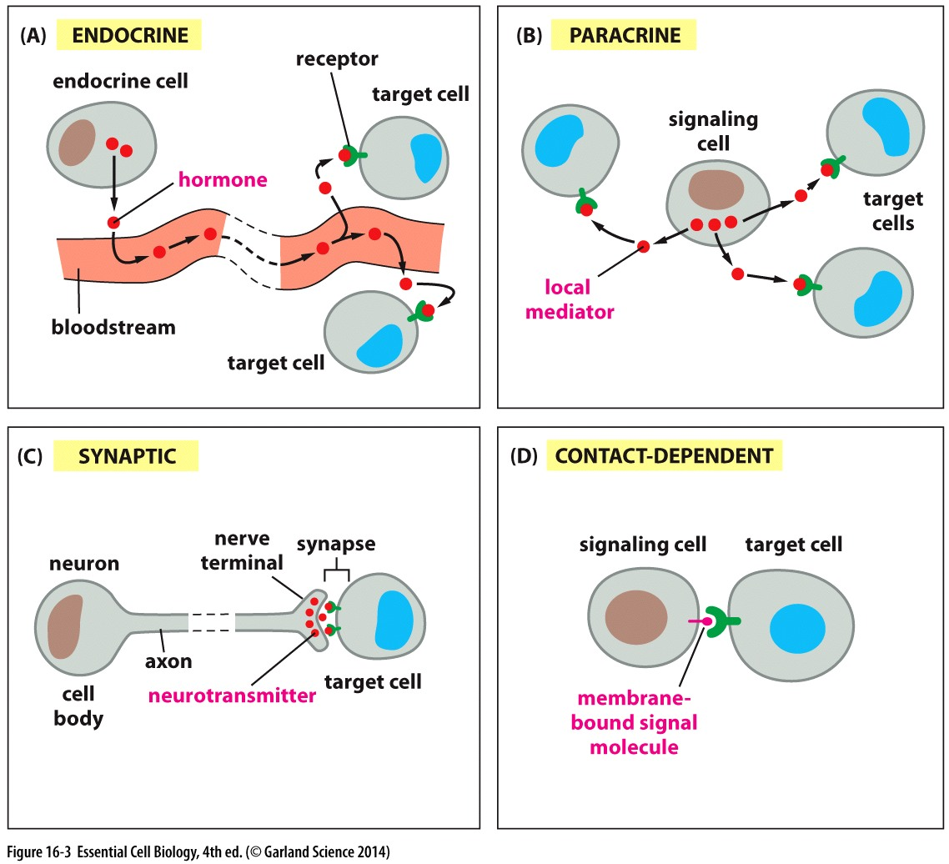
Long & short range signals
Long/mid range signals may be systemic & travel in blood or local in extracellular fluid
1 input source, many targets
Short range signals require direct (or near direct) contact
I input, 1 target

Slide 40
Receptor specificity limits signal response
MANY signal molecules
Cells ONLY respond to those they have receptors for
Each receptor activated by a SINGLE signal

Slide 41
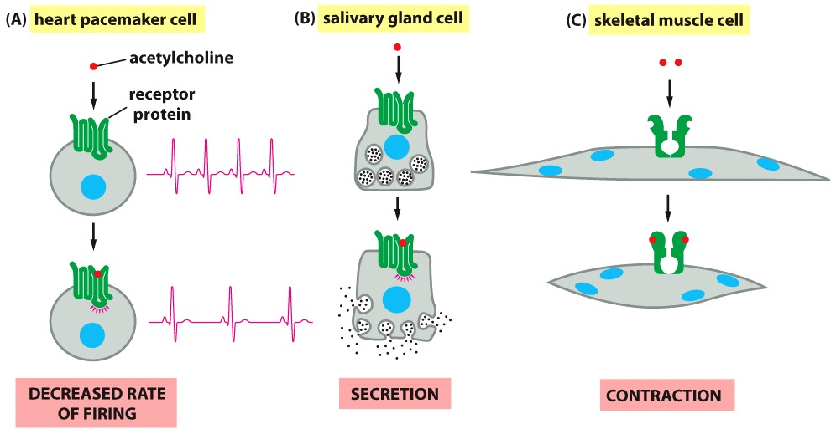
One signal, Many cells
Different output in different target cells, even with same INPUT (same signal & same receptor)
Cellular response is dictated by the intracellular effector proteins
Different effectors in different cells = Complex/differential behavioral response to a single stimuli

Slide 42
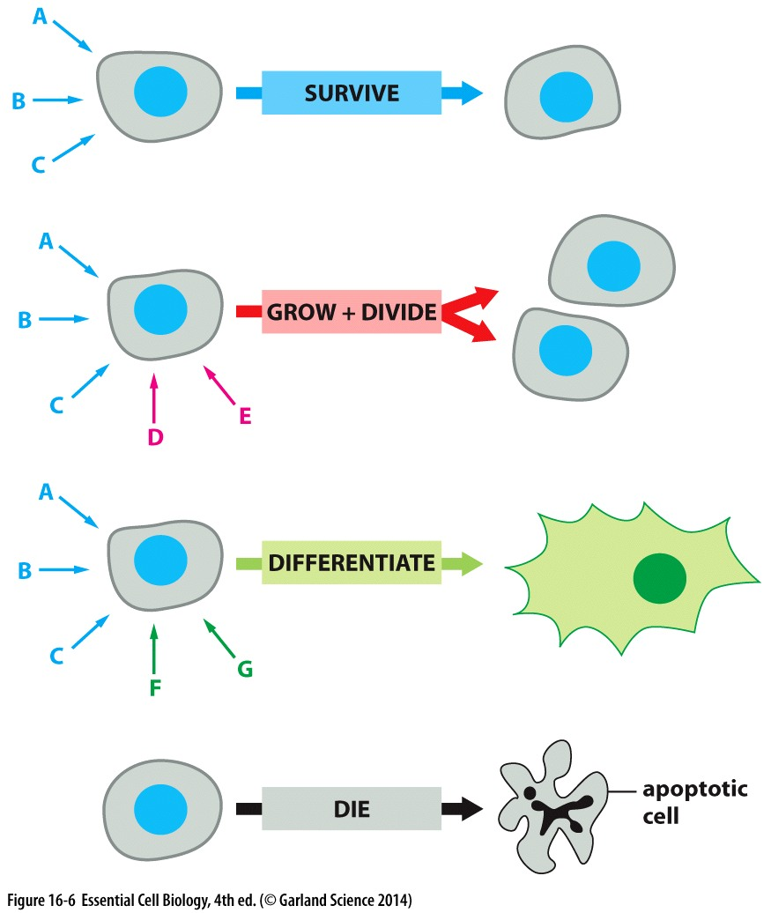
One cell many signals
Complex behaviors require ability to sense a variety of signals
Each signal has it’s own receptor (input)
Each signal/receptor has it’s own downstream effector proteins
Effector molecules regulate cellular behavior (output)
Speed of response depends on what needs to be accomplished in response to stimuli (muscle contraction vs cell division)

Slide 43
Signaling pathways and molecules

Slide 44
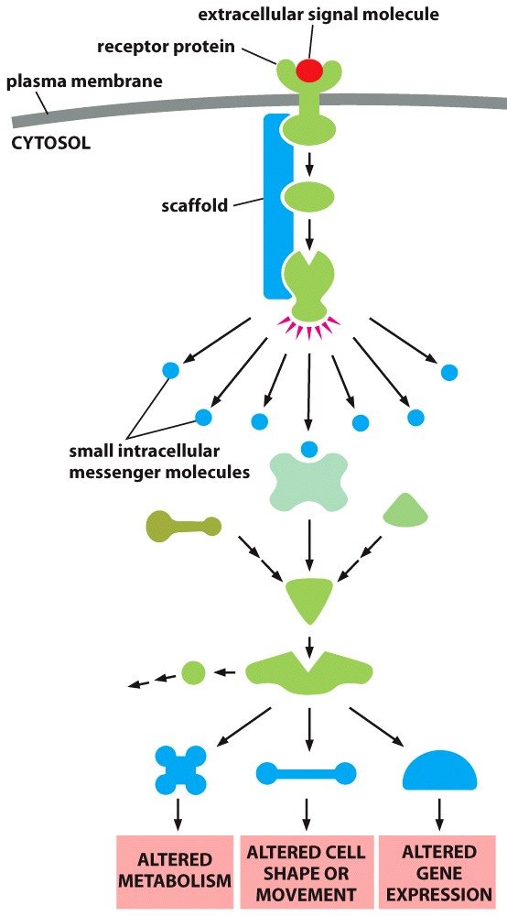
Intracellular signaling pathways respond to external stimuli
A signaling cascade transmits the message
Intracellular signaling molecules can:
Relay
Amplify
Integrate
Distribute
Enable diverse and multifaceted cellular response to a single stimuli
Intracellular signaling molecules
Effector proteins
Target cell
responses

Slide 45
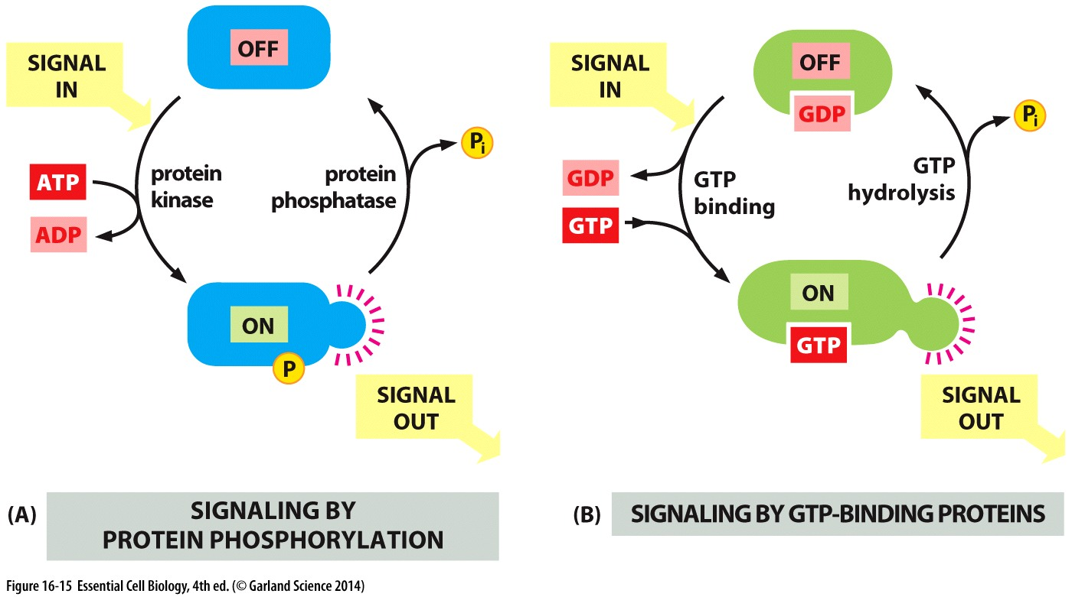
Intracellular signaling as a molecular switch
Molecular Switch Proteins: addition or removal of a phosphate to regulate function

Slide 46
Cell Surface receptors

Slide 47
Cell Surface Receptors
Transmembrane proteins with extracellular and intracellular domains
Extracellular domain: receives signal as binds ligand
Intracellular domain: initiates signal cascade
Ion-channel-coupled receptors
G-protein-coupled receptors
Enzyme-coupled receptors

Slide 48
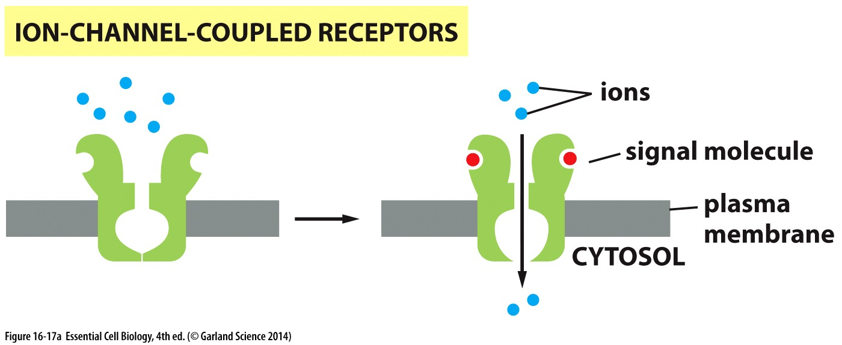
Cell Surface Receptors
Transmembrane proteins with extracellular and intracellular domains
Extracellular domain: receives signal as binds ligand
Intracellular domain: initiates signal cascade
Ion-channel-coupled receptors
Ligand binding opens the ion channel
Influx of ions is the output/start of signal cascade

Slide 49
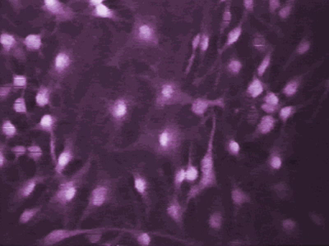
Neurons relay message via ion-channel-coupled receptors
Signaling molecule: Neurotransmitters from neighboring cells
Receptor:
Ion-Channel-Coupled receptor opens a calcium ion channel
Response:
Rapid influx of calcium ions

Slide 50
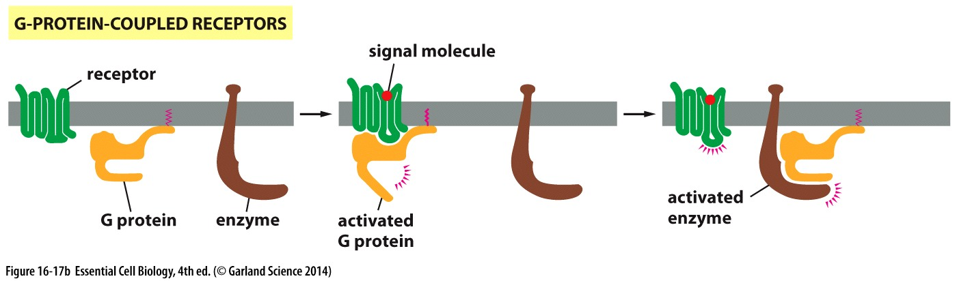
Cell Surface Receptors
Transmembrane proteins with extracellular and intracellular domains
Extracellular domain: receives signal as binds ligand
Intracellular domain: initiates signal cascade
Ion-channel-coupled receptors
G-protein-coupled receptors
Ligand binding activates the receptor
Active receptor activates G protein (complex)
Active G protein regulates an enzyme/ion channel
All 3 are integral/anchored to the SAME membrane

Slide 51
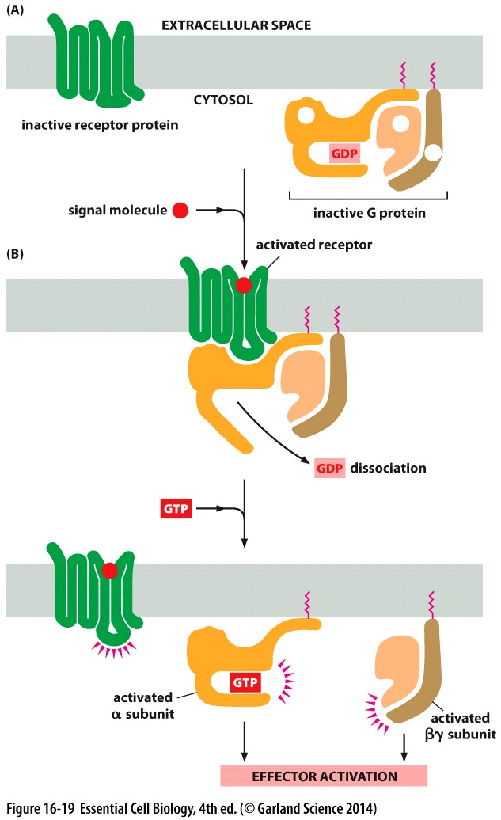
G-Protein-coupled receptors: How things get done!
*Hundreds of GPCRs * varied signal molecules * diverse cellular processes*
Each has a similar 7 α-helix transmembrane domain STRUCTURE
Attractive drug targets → 1/3 of existing drugs target GPCRs
G Protein regulation:
INACTIVE
3 subunits (2 membrane associated) bound with GDP

Slide 52
G-Protein-coupled receptors: How things get done!
G Protein regulation:
INACTIVE
3 subunits (2 membrane associated) bound with GDP
ACTIVE
Ligand binds and activates the receptor
Receptor causes α-subunit to lose affinity for GDP
Binds GTP → conformational change
α-subunit active
βγ−subunit released and active

Slide 53
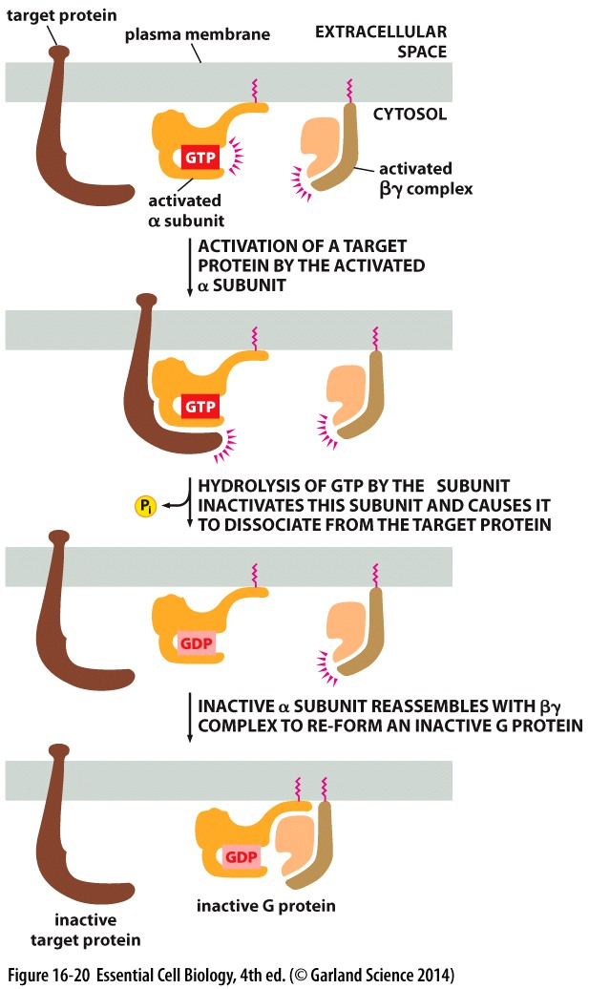
G-Protein-coupled receptors: how things get done!
G Protein recycling:
GTP → GDP + P hydrolysis regulates duration of α-subunit activity
G Protein complex reforms to inactivate βγ-subunit
G protein ready to be re-used in next round of signaling

Slide 54
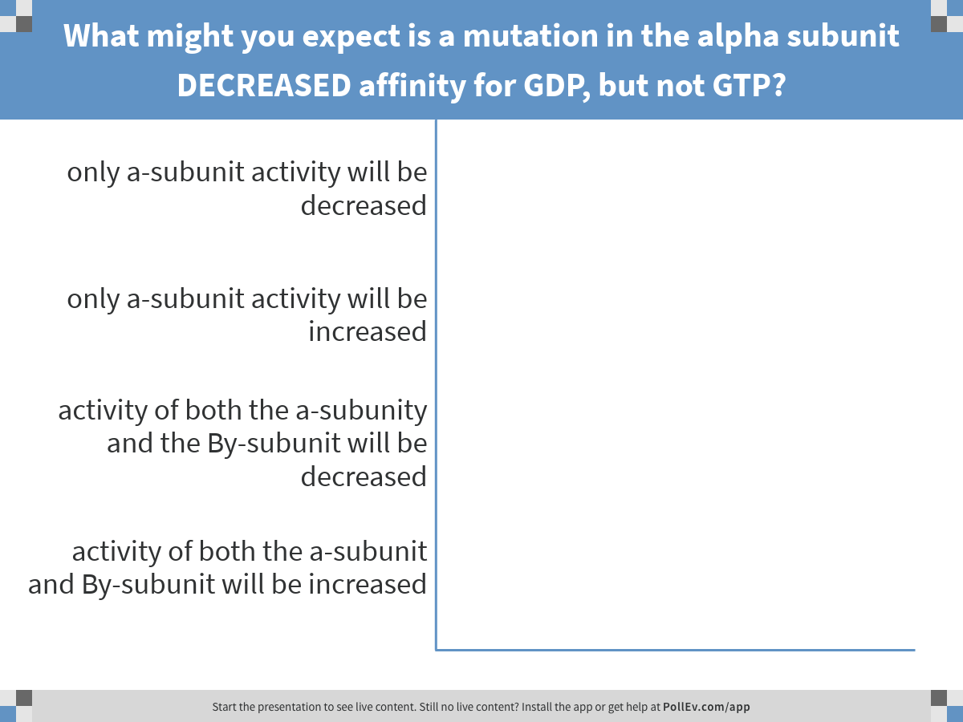
Regulation of G protein activity relies on affinities for GTP and GDP, and rates of hydrolysis
Notes:
What might you expect is a mutation in the alpha subunit DECREASED affinity for GDP, but not GTP?
https://www.polleverywhere.com/multiple_choice_polls/XXYtyOFh0SOpu58

Slide 55
G-protein regulation
In the absence of GDP binding…
Would be impossible to maintain an inactive state
Cytoplasmic GTP levels >> GDP levels
Release of GDP rapidly leads to binding of GTP → activation of BOTH α, and βγ subunits

Slide 56
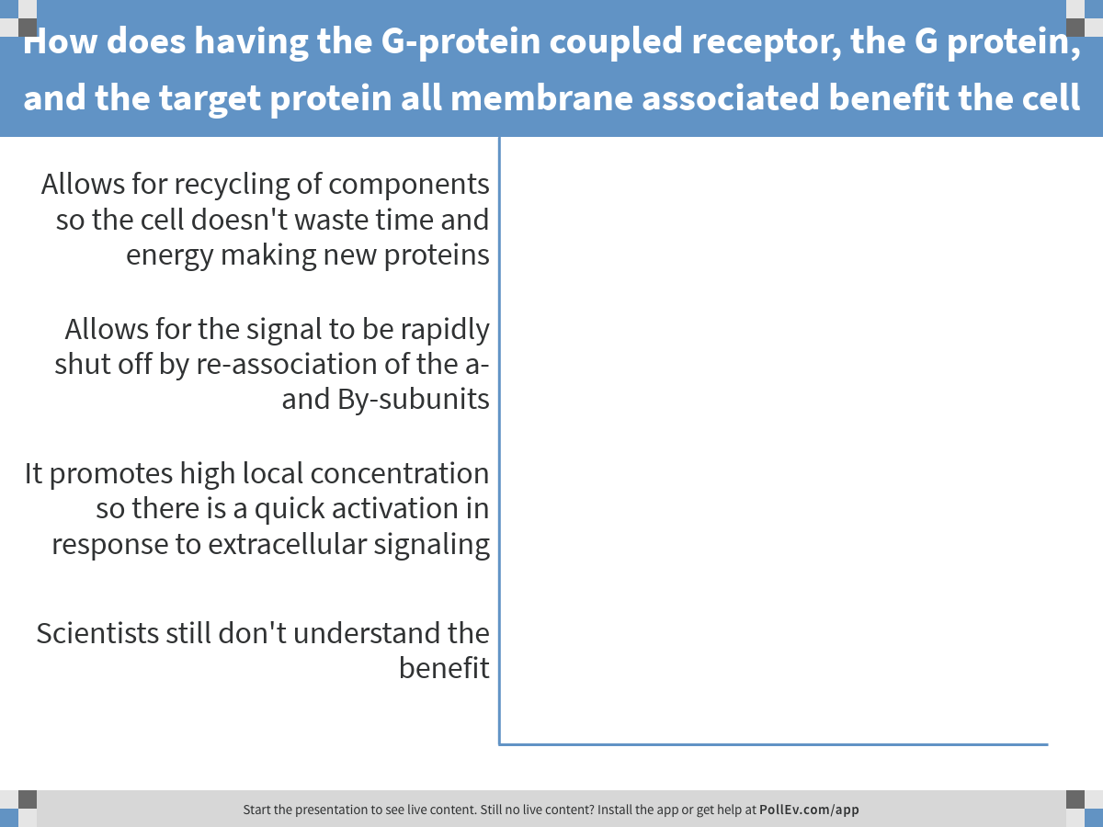
Notes:
How does having the G-protein coupled receptor, the G protein, and the target protein all membrane associated benefit the cell
https://www.polleverywhere.com/multiple_choice_polls/1yE2zMDrIpn67EL

Slide 57
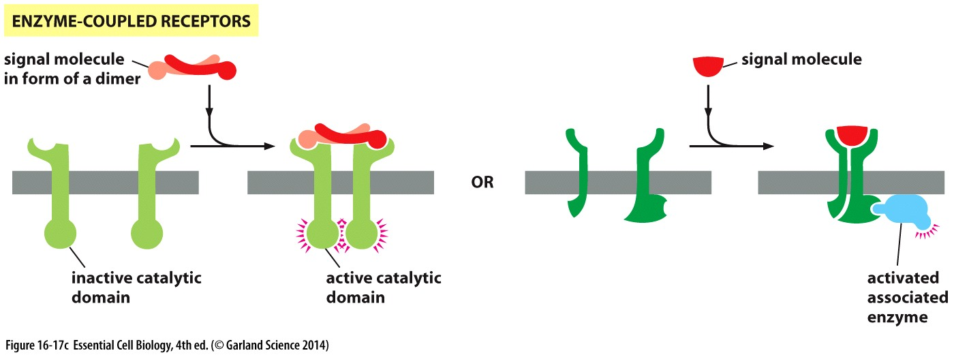
Cell Surface Receptors
Transmembrane proteins with extracellular and intracellular domains
Extracellular domain: receives signal as binds ligand
Intracellular domain: initiates signal cascade
Ion-channel-coupled receptors
G-protein-coupled receptors
Enzyme Coupled Receptors
Signaling/binding of ligand to a receptor turns on enzyme activity
Often function as dimers
Receptor may have intrinsic catalytic activity OR be associated with an enzyme

Slide 58
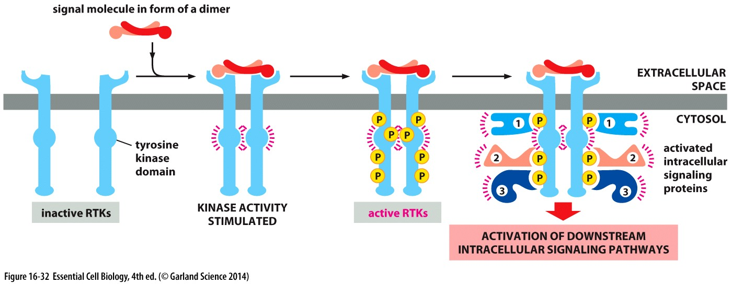
Enzyme Coupled Receptors: Kinase activity
Active kinase auto-phosphorylate
Recruit & activate a complex of intracellular signaling proteins (sometimes other kinases)
Can phosphorylate downstream targets

Slide 59
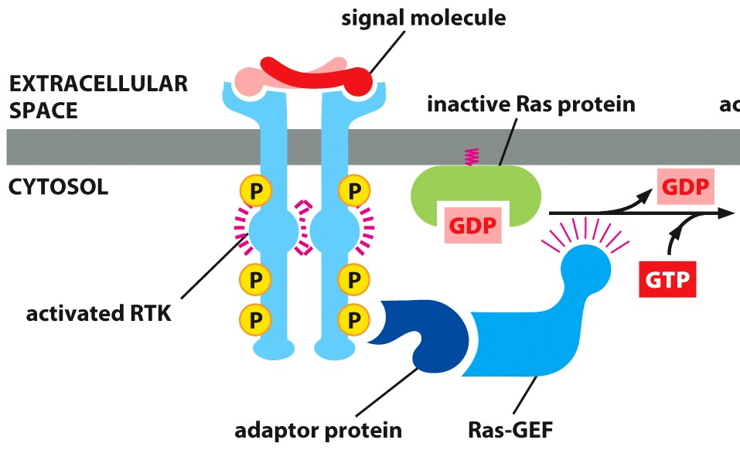
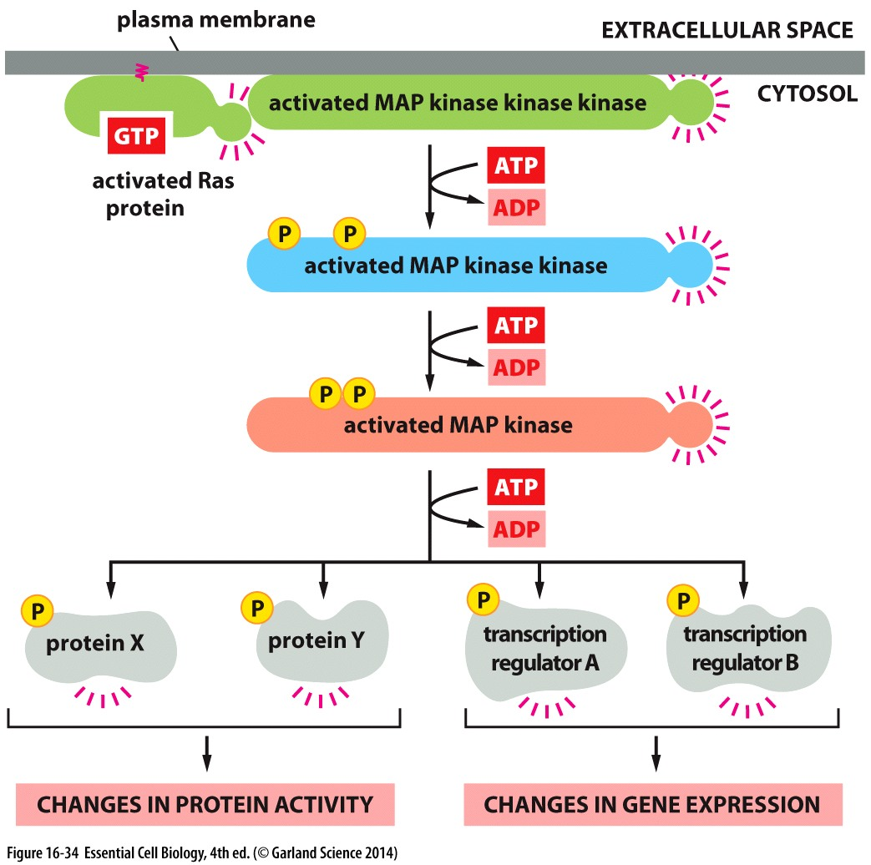
Signal cascade to control complex behavior
Receptor is activated
Signal is relayed to Ras (a GTPase)
Ras initiates a kinase cascade
Kinases amplify the signal
Target proteins integrate the signal to coordinate a response

